Slide 1
Mental Health Attitudes and Work
An investigation of survey data from
Open Sourcing Mental Illness
Conducted in partial completion of
IS/DATA 621, City University of New York
May, 2018

Slide 2
An Analysis By
Andy Carson
Raphael Nash
Joel Park
Joy Payton
Walt Wells

Slide 3
Motivations
All of us are avid users of open source software, write code, and are information professionals.
Some of us have careers in medicine.
All of us know someone who struggles with mental illness.
We have all managed other employees and want healthy coworkers, colleagues, and direct reports.
We want to understand what promotes access to mental health care in information workers.

Slide 4
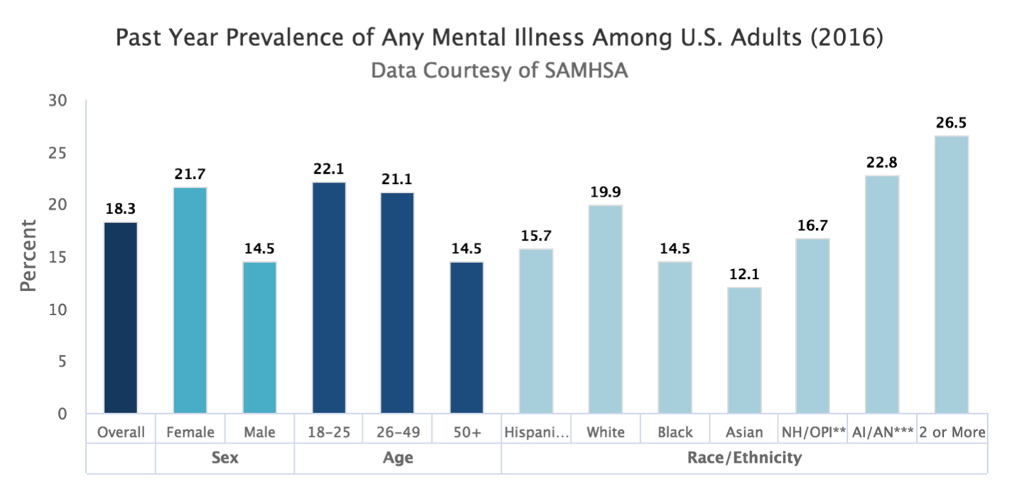
Motivations

Slide 5
Open Sourcing Mental Illness
https://osmihelp.org/

Slide 6
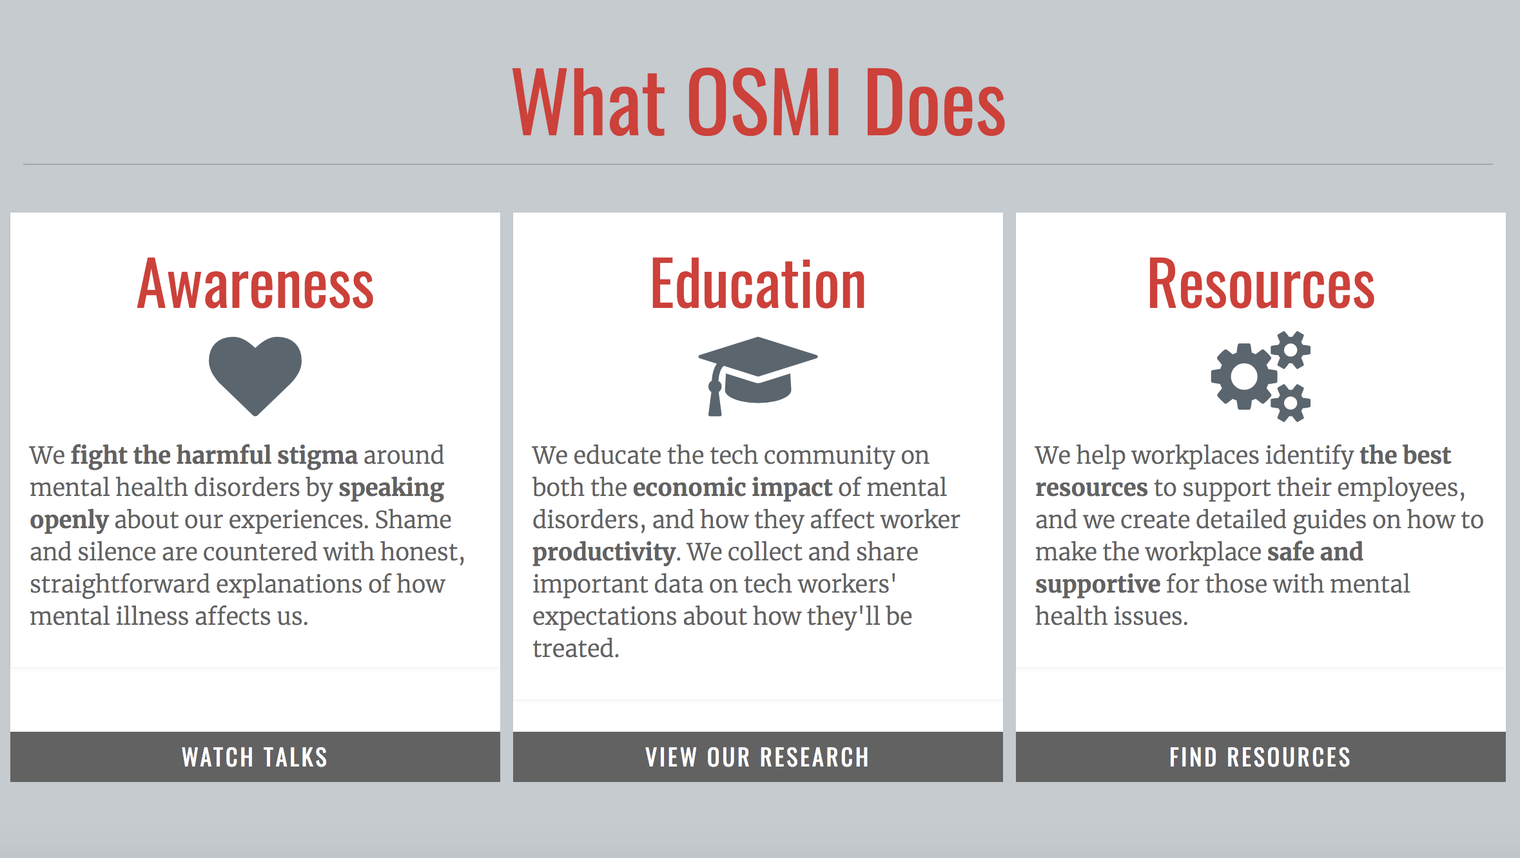
Open Sourcing Mental Illness

Slide 7
OSMI Data
Open Sourcing Mental Illness (OSMI) offered its mental health survey in 2014, 2016, and 2017.
Data is available for 2014 and 2016.
We used 2016 data, licensed under Attribution-ShareAlike 4.0 International (CC BY-SA 4.0). Therefore our findings here are shared under the same license. For more information please see https://creativecommons.org/licenses/by-sa/4.0/

Slide 8
OSMI Data
Survey data is collected anonymously, with no identifying information (no IRB / Ethics oversight required).
Some questions are posed about the person answering the survey, such as “What is your gender?”, “Do you work remotely?”, “Do you have a family history of mental illness?”.
Other questions ask about that person’s employer (e.g. “Do you think that discussing a mental health disorder with your employer would have negative consequences?”)
Some questions can be answered in a free-text format, others are multiple choice.

Slide 9
Limitations and Challenges
Survey is offered in English only
No tracking of participation (people could choose to respond multiple times)
Free text fields (e.g. gender) need to be consolidated to categorical answers
Self-selection / sampling biases exist (predominantly North American, likely engaged / interested in the topic)
Information about employer is gathered from employees (may be inaccurate)

Slide 10
Data Cleaning
Notes field mined for useful information that could clear up ambiguous answers
Gender field consolidated into M/F/Other
Removal of unhelpful / sparse questions like U.S. State

Slide 11
Analytics Approach
Aim: model seeking professional mental health services as the dependent variable based on responses to other questions
Logistic regression using logit
Three models, of increasingly constrained feature sets, all with AUC above 0.89
A balanced model with 8 predictors and AUC of 0.91 explains nearly half the variance in whether help is sought from professional mental health services.

Slide 12
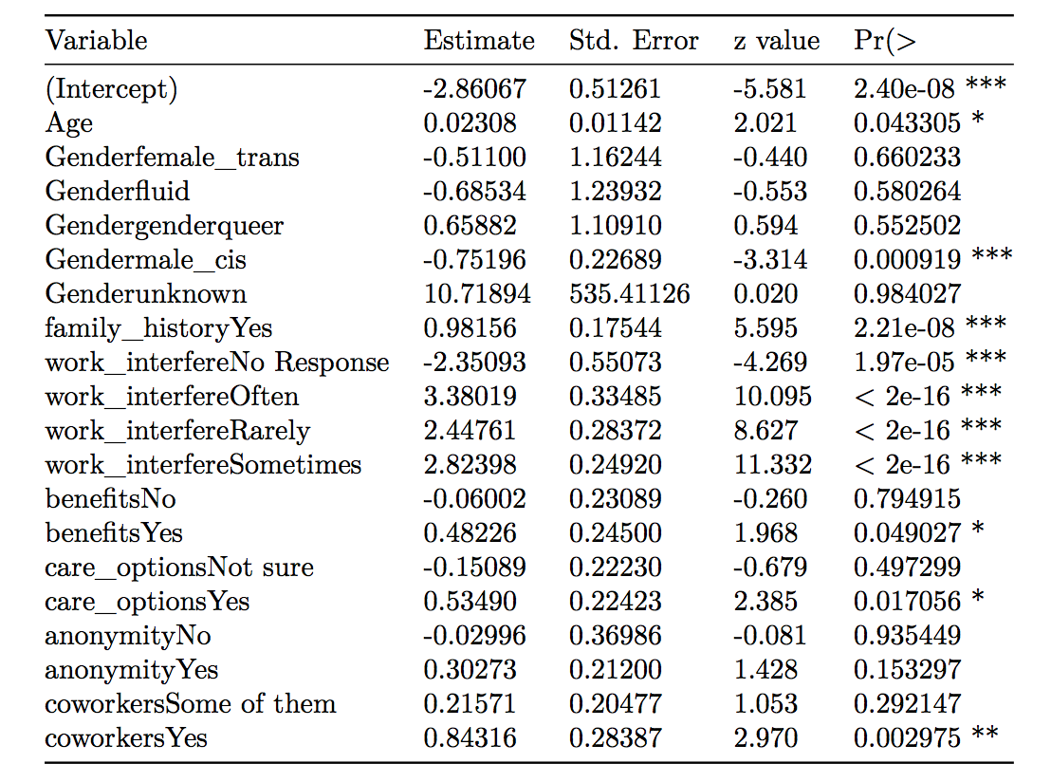
SELECTED MODEL

Slide 13
Notable findings
Predictive variables within a company’s control that encourage the treatment of mental health include
An employer offering mental health benefits
An employee being well informed about the options offered by the employer for mental health treatment
Anonymity being maintained when an employee makes use of mental health or substance abuse treatment resources offered by the employer
Predictive variable about the employee’s self-evaluation that encourages the treatment of mental health
Mental health issue affecting work productivity

Slide 14
Participate!
To join in the data gathering for the next round of OSMI research, please visit https://osmi.typeform.com/to/XYupsC.

